Slide 1

Ref. Book Programming in ANSI C- 7th Edition E. Balagurusamy
CH-7 Array

Slide 2
Presented by Teresa Jency Bala ID-19 385 20 113 Department CSE Imperial College of Engineering, Khulna Affiliated By Rajshahi University

Slide 3

Learning objectives:
Define the concept of arrays
Determine how one-dimensional array is declared and initialized
Know the concept of two-dimensional arrays
Discuss how two-dimensional array is declared and initialized
Describe multi-dimensional arrays
Explain dynamic arrays

Slide 4
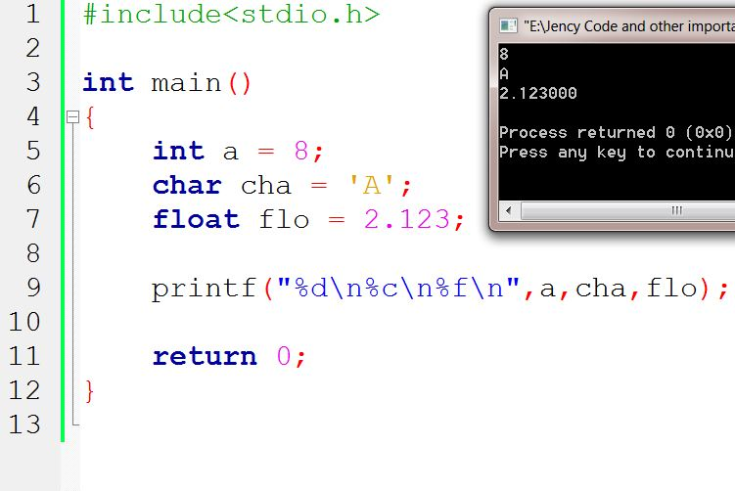
Introduction: Normally one variable of one datatype can hold only one value
4

Slide 5
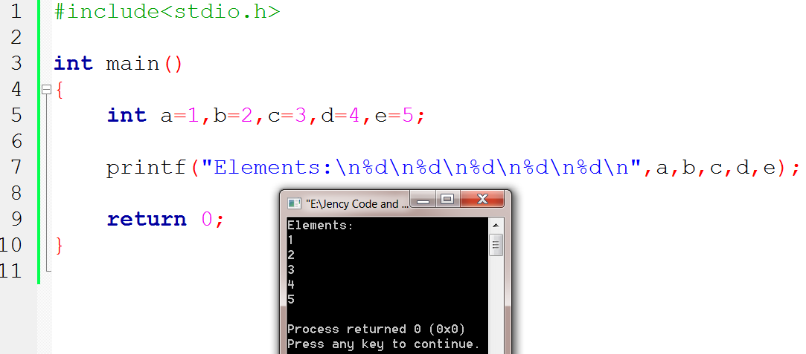
We don’t need to declare values for elements. Like below:
5

Slide 6
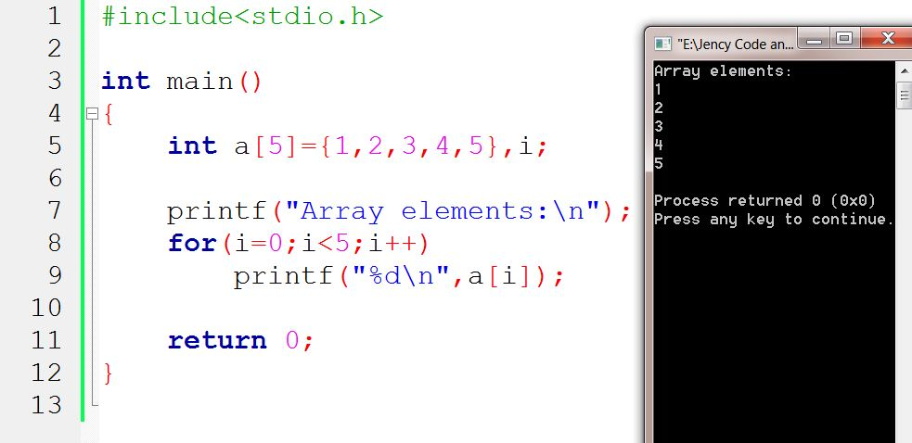
What is array?
An array is a fixed size sequenced collection of elements of the SAME datatype. The idea is to store multiple items of the same type together.
Syntax to declare array:
datatype variable-name [size];
a[0]= 1
a[1]= 2
a[2]= 3
a[3]= 4
a[4]= 5
6

Slide 7
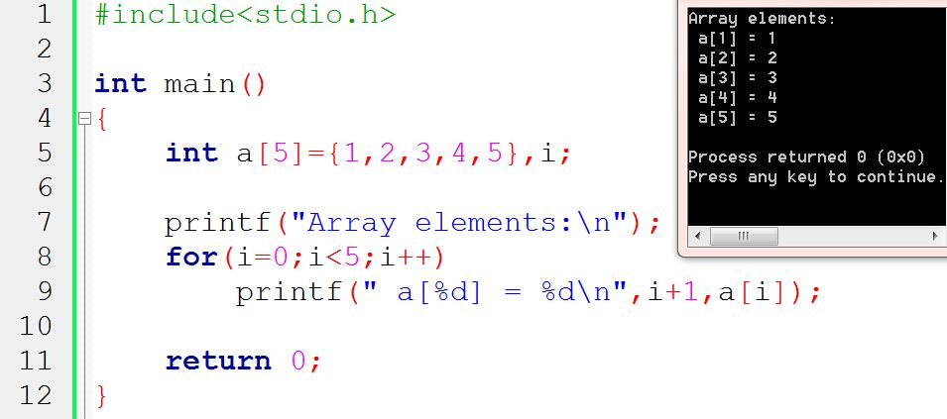
One-dimensional:
Just by declaring one variable we can put an INDEX number which is merely the number variables.
We can index starting with 0 which is preferred by computer.
But we shouldn’t get confused so we can state indexing with 1.
7

Slide 8
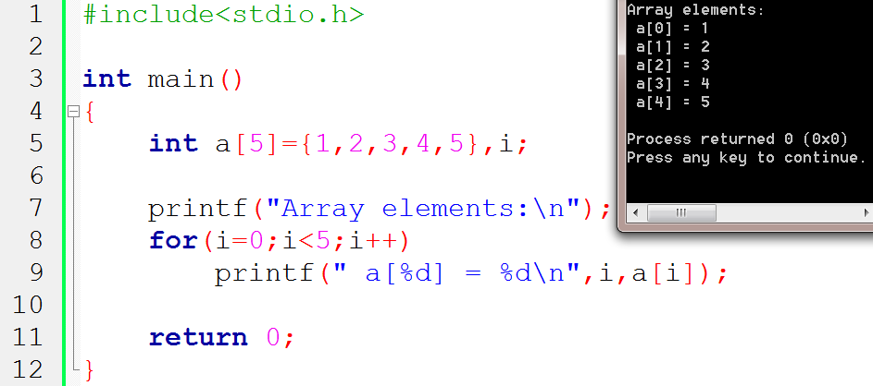
OR,
i
i
8

Slide 9
Compile Time Initialization:
We can initialize the elements of array in same way as the ordinary variable when they are declared.
Datatype array-name [size] = {list of values}
int number[3] = {0, 1, 2};
We can omit the size during compile time initialization only.
int number[ ] = {1, 2, 3, 4};
This approach works fine as long as we initialize every element in the array.
9

Slide 10
Character array Initialization :
char name[ ] = {‘J’,ʻe’,ʻn’,ʻc’,ʻy’,ʻ\0’};
or,
char name[ ]=ʺJency”;
Compile time initialization may be partial. That is, the number of initialize may be less than the declared size.
int number[5]={10, 20, 30};
Here, array index number initialized is 5 but there are 3 elements.
The remaining 2 places are Zero and if the array type is char Null.
int number[2] = {1,2,3,4};
In this case the declared size has more initialized elements. The compiler will create error.
10

Slide 11
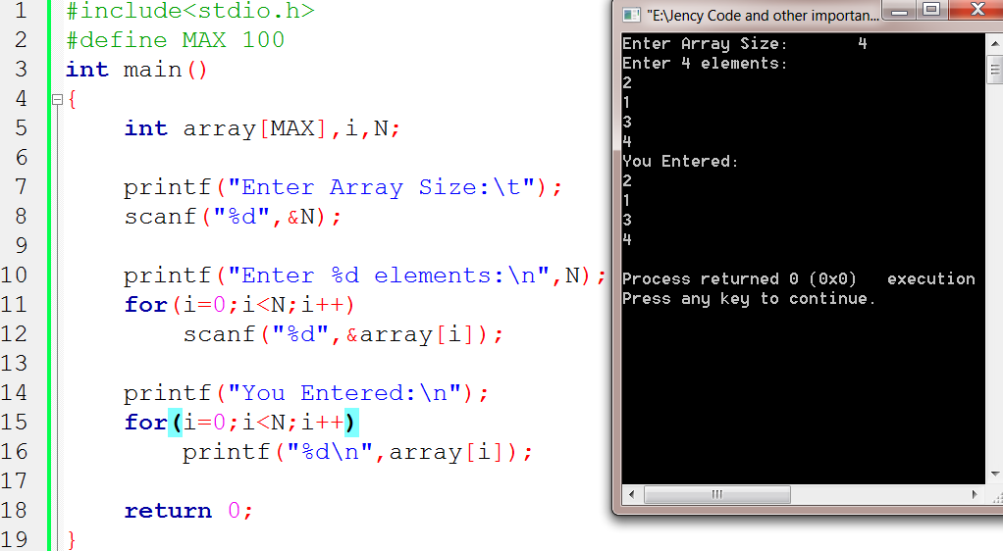
Run time initialization:
An array can be Explicitly initialized at run time. This approach is usually applied for initializing user input data. Using for loop can help in this case.
11

Slide 12
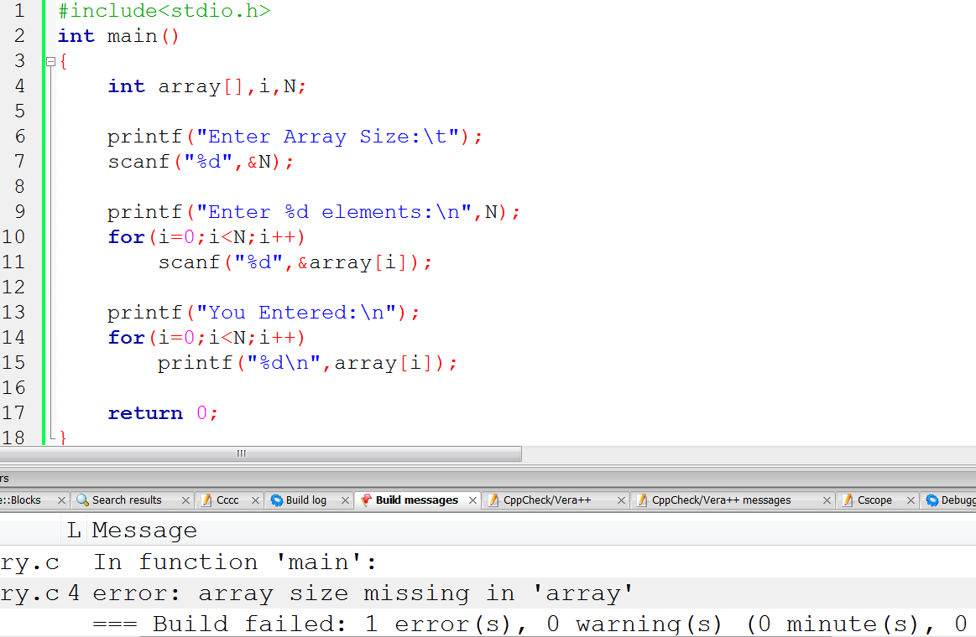
We can’t leave size empty in array
12

Slide 13
Searching And Sorting:
Sorting: The process of arranging elements in the list according to their values, in ascending or descending order. A sorted list is called an ordered list. Sorted lists are especially important in list searching because they facilitate rapid search operation.
Important and simple sorting techniques:
Bubble sort
Selection sort
Insertion sort
Searching: The process of finding the location of the specific element in a list. The specified element is often called the search key. If the search key with list element values, the search is said to be successful else unsuccessful.
The most commonly used search techniques are:
Sequential Search
Binary Search
Shell sort
Merge sort
Quick sort
13

Slide 14
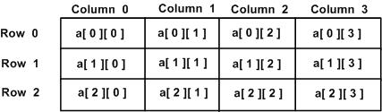
Two-dimensional Arrays:
We represent a particular value in matrix using 2 subscripts such as v_{rc} here, r is for row and c is for column.
Syntax:
datatype array_name[row_size][column_size];
Like single-dimensional arrays, each dimension of the array is indexed from zero to its maximum size-1.
The first index selects the row and the second index selects the column within row.
14

Slide 15
2D Array Compile time initialization:
Array size declaration and values initialized in braces:
int table[2][3]={0, 0, 0, 1, 1, 1};
OR,
int table[2][3] = {{0, 0, 0},{1, 1, 1} };
OR,
int table[2][3] = { {0, 0, 0},
{1, 1, 1}
};
The initialization is done row by row
We can initialize a two dimensional array in the form of matrix
15

Slide 16
OR,
int table[ ][3] = {
{0, 0, 0},
{1, 1, 1}
};
*****************************
int table[2][3] = {
{1,2},
{2}
};
*****************************
int table[2][3] = {{0}, {0}, {0}};
or,
int table[2][3] = {0, 0};
When the array is completely initialized with all values, explicitly, we need not specify the size of the dimension
If the values are missing in initialize, they are automatically set to Zero
When all the elements are to be initialized to Zero, this short-cut may be used
16

Slide 17
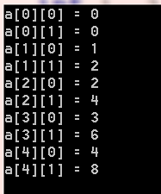
#include <stdio.h>
int main () {
/* an array with 5 rows and 2 columns*/
int a[5][2] = { {0,0}, {1,2}, {2,4}, {3,6},{4,8}};
int i, j;
/* output each array element's value */
for ( i = 0; i < 5; i++ ){
for ( j = 0; j < 2; j++ ) {
printf("a[%d][%d] = %d\n", i, j, a[i][j] );
}
}
return 0;
}
17

Slide 18
2D matrix Run time Input and Display:
#include<stdio.h> #define MAX 10 int main() { int array[MAX][MAX],i, j, r, c; printf("Enter row and column number:\n"); scanf("%d %d", &r, &c); printf("Enter %d X %d elements:\n", r, c); for(i = 0; i <r; i++) { for(j=0;j<c; j++) { printf("Enter array[%d][%d]: ",i+1,j+1); scanf("%d", &array[i][j]); } } | printf("Your entered 2D matrix of %dX%d elements:\n", r, c); for(i=0;i<r; i++) { for(j=0;j<c; j++) { printf("%5d", array[i][j]); } printf("\n"); } return 0; }
18

Slide 19
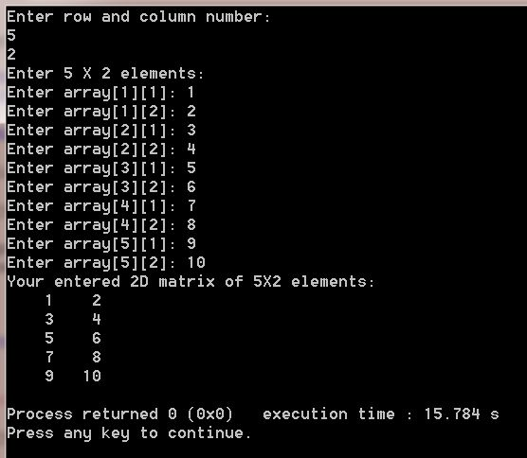
19

Slide 20
Multi-dimensional arrays:
C allows three or more dimensions.
The exact limit is determined by the compiler. It's an array or collection of 2D arrays, and a 2D array is an array of 1D array.
The general form of a multi-dimensional array is
datatype arrary_name[s1][s2]…..[s_{i}];
here s_{i} is size of i-th dimension.
Examples:
int survey[3][5][12]; >>holds: 3*5*12=180 integer type elements<<
20

Slide 21

Declaration and Initialization 3D Array :
#include<stdio.h> int main() { int i, j, k; int arr[3][3][3]= { { {11, 12, 13}, {14, 15, 16}, {17, 18, 19} }, { {21, 22, 23}, {24, 25, 26}, {27, 28, 29} }, { {31, 32, 33}, {34, 35, 36}, | {37, 38, 39} }, }; printf(":::3D Array Elements:::\n\n"); for(i=0;i<3;i++) { for(j=0;j<3;j++) { for(k=0;k<3;k++) { printf("%d\t", arr[i][j][k]); } printf("\n"); } printf("\n"); } return 0; }
21

Slide 22
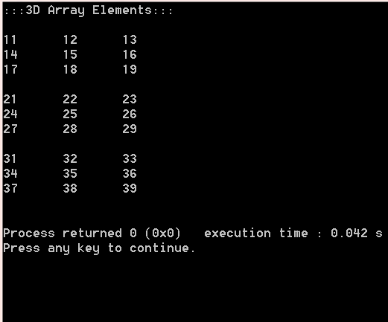
22

Slide 23
Dynamic Array:
We create arrays at compile time. An array created at compile time by specifying SIZE in the source code has a fixed size and cannot be modified at run time. The process of allocating memory at compile time is known as Static Memory Allocation.
Considering a situation where we want to use array that can vary greatly in size. In C it is possible to allocate memory to array at run time are called Dynamic arrays.
Dynamic arrays are created using what are known as pointer variables and memory management function malloc, calloc and realloc. These functions are included in header file <stdlib.h>. These are used in data structure such as linked lists, stacks and queues.
23

Slide 24

Thank You!!!!!! FOR YOUR PATIENCE
Jency

